Slide 1
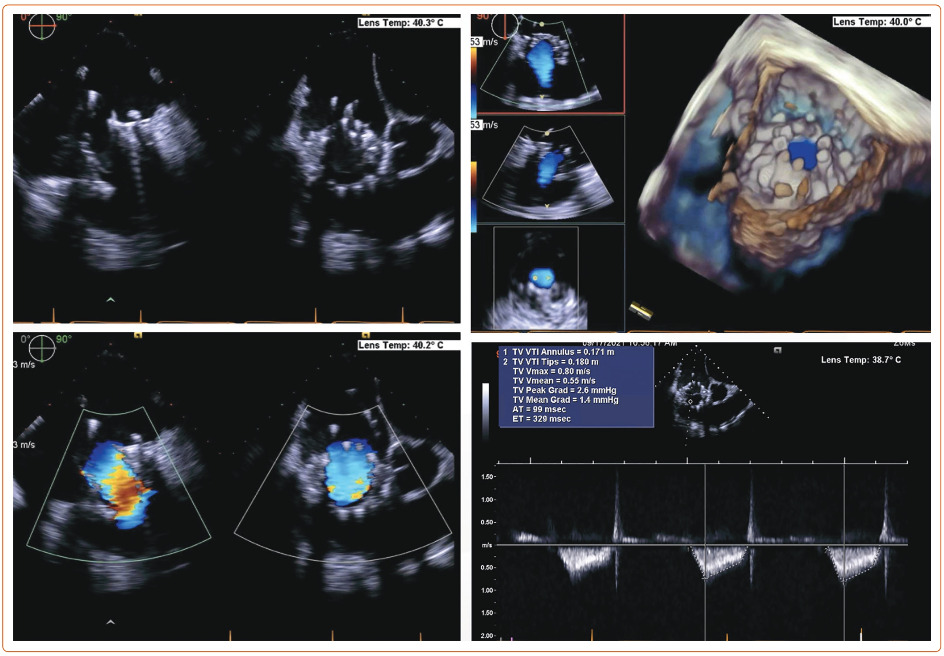
Asim Shabbir M, Yadav P, Tiwari N, Velagapudi P
Figure 5: Transesophageal Echocardiogram Immediately Postprocedure Showing Reduction in Tricuspid Regurgitation Grade to Mild
Citation: US Cardiology Review 2023;17:e11.
https://doi.org/10.15420/usc.2023.07

