Slide 1
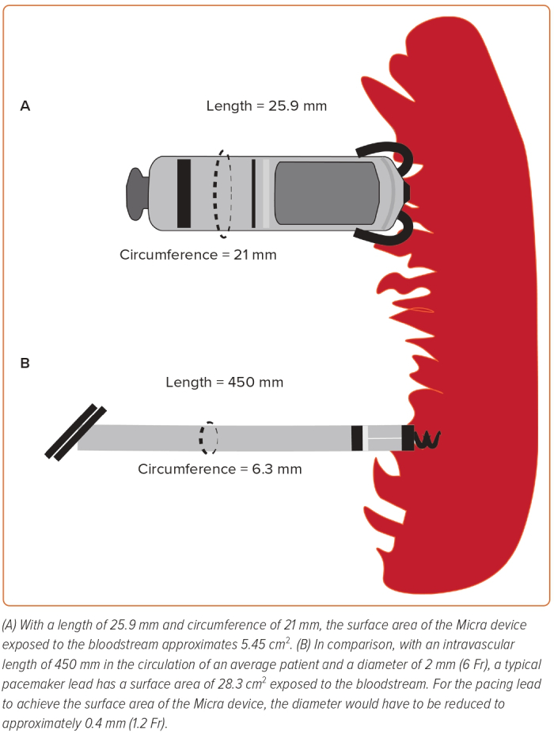
Akhtar Z, Sohal M, Gallagher MM
Figure 1: Differences in Surface Area Between a Leadless Pacemaker and a Pacing Lead
Citation: European Cardiology Review 2023;18:e50.
https://doi.org/10.15420/ecr.2022.58

