Slide 1
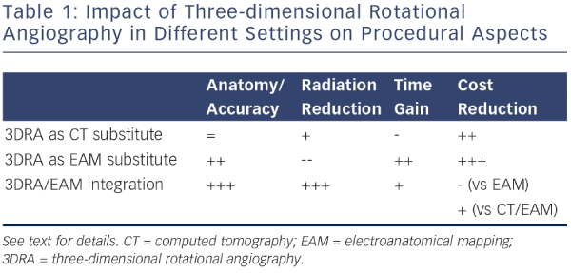
De Potter TJ, Bardhaj G, Viggiano A, Morrice K, Geelen P
Impact of Three-dimensional Rotational Angiography in Different Settings on Procedural Aspects
Citation: Arrhythmia & Electrophysiology Review 2014;3(3):173–6
https://doi.org/10.15420/aer.2014.3.3.173

