Slide 1
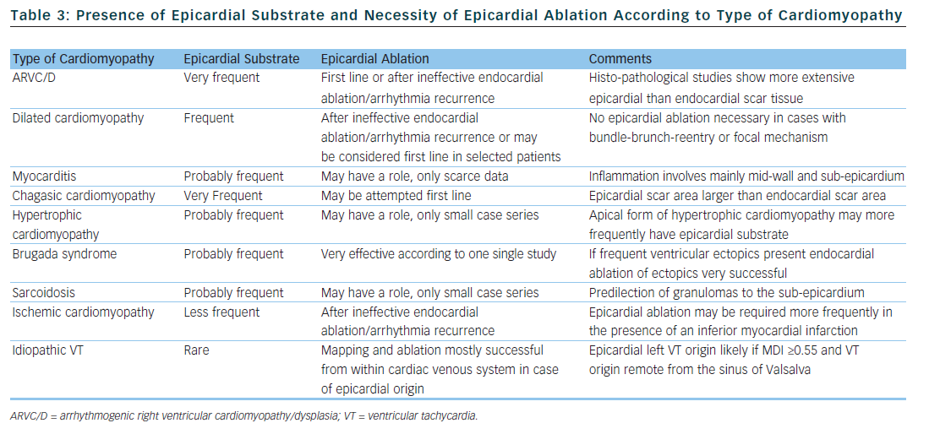
Roten L, Daly M, Pascale P, Komatsu Y, Ramoul K, Scherr D, Chaumeil A, Shah AJ, Denis A, Derval N
Table 3: Presence of Epicardial Substrate and Necessity of Epicardial Ablation According to Type of Cardiomyopathy
Citation: Arrhythmia & Electrophysiology Review 2012;1(1):39–45
https://doi.org/10.15420/aer.2012.1.39

