Slide 1
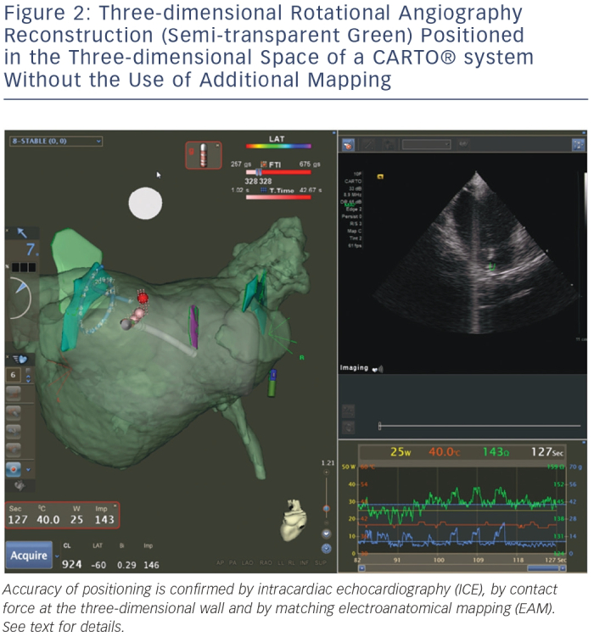
De Potter TJ, Bardhaj G, Viggiano A, Morrice K, Geelen P
Three-dimensional Rotational Angiography Reconstruction (Semi-transparent Green) Positioned in the Three-dimensional Space of a CARTO® system Without the Use of Additional Mapping
Citation: Arrhythmia & Electrophysiology Review 2014;3(3):173–6
https://doi.org/10.15420/aer.2014.3.3.173

