Slide 1
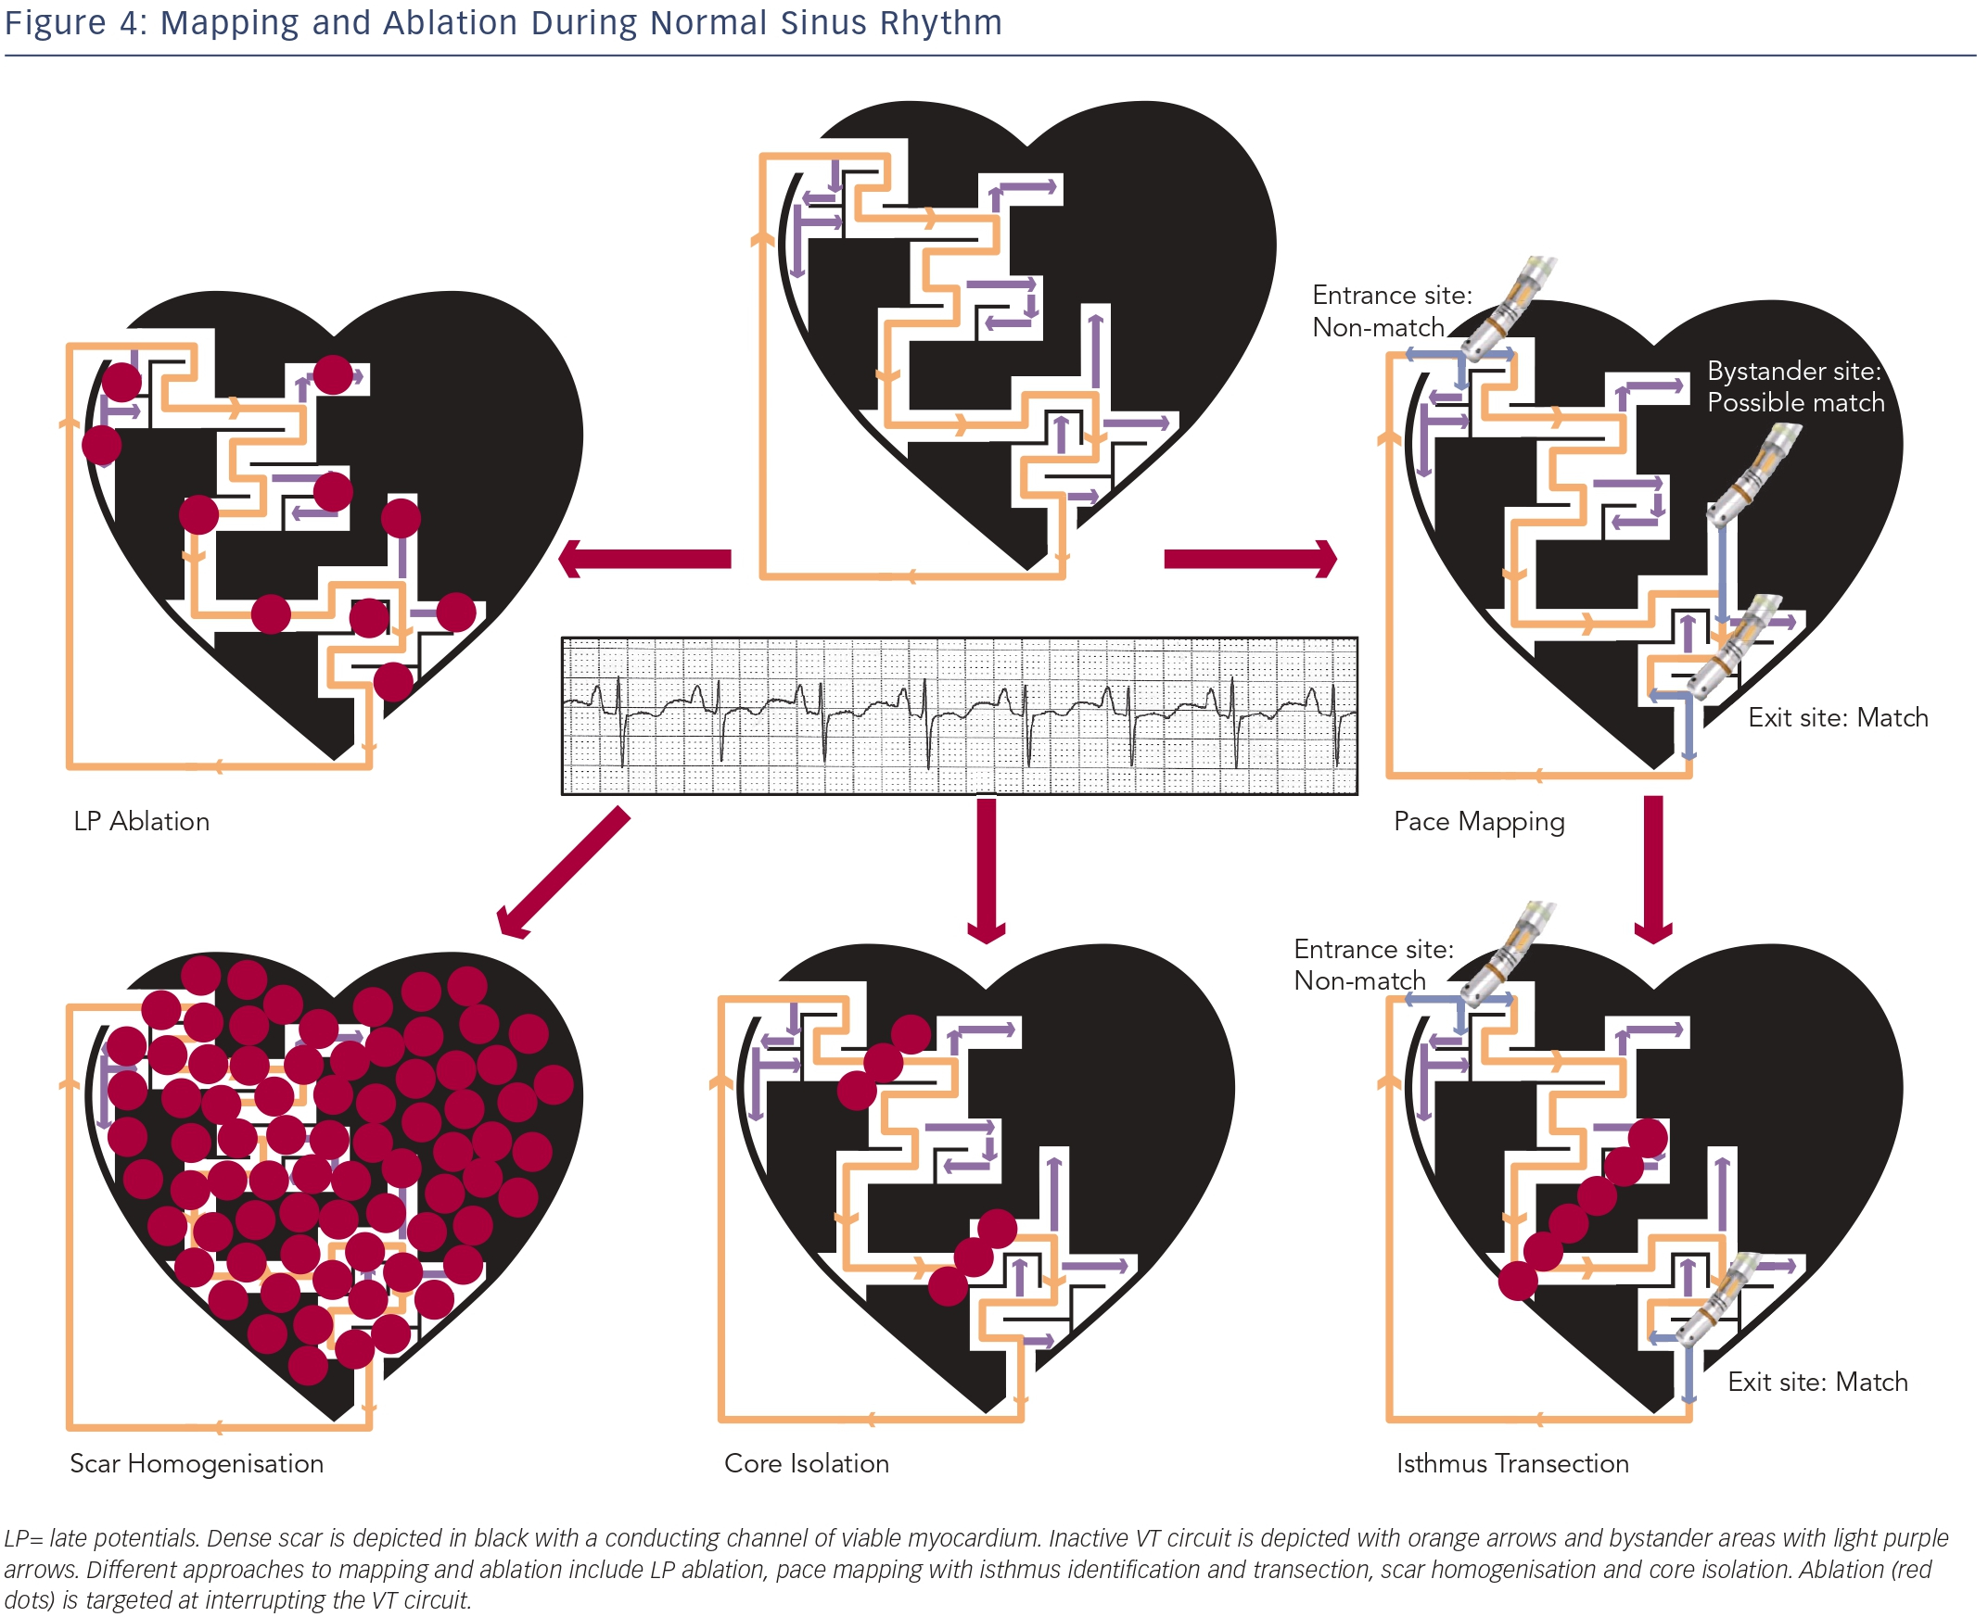
Sadek MM, Schaller RD, Supple GE, Frankel DS, Riley MP, Hutchinson MD, Garcia FC, Lin D, Dixit S, Zado ES, Callans DJ, Marchlinski FE
Mapping and Ablation During Normal Sinus Rhythm
Citation: Arrhythmia & Electrophysiology Review 2014;3(3):161–7
https://doi.org/10.15420/aer.2014.3.3.161

