Slide 1
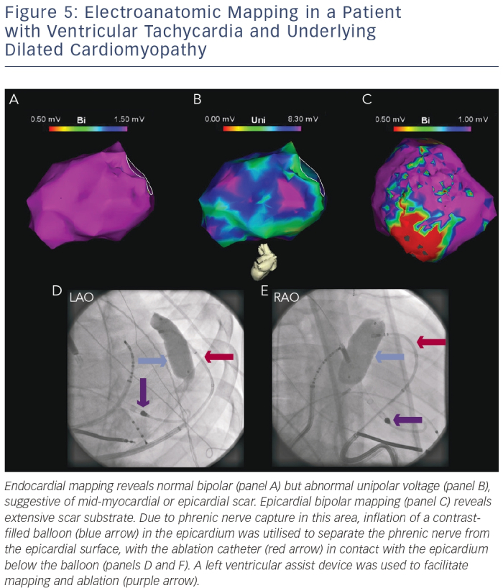
Sadek MM, Schaller RD, Supple GE, Frankel DS, Riley MP, Hutchinson MD, Garcia FC, Lin D, Dixit S, Zado ES, Callans DJ, Marchlinski FE
Electroanatomic Mapping in a Patient with Ventricular Tachycardia and Underlying Dilated Cardiomyopathy
Citation: Arrhythmia & Electrophysiology Review 2014;3(3):161–7
https://doi.org/10.15420/aer.2014.3.3.161

