Slide 1
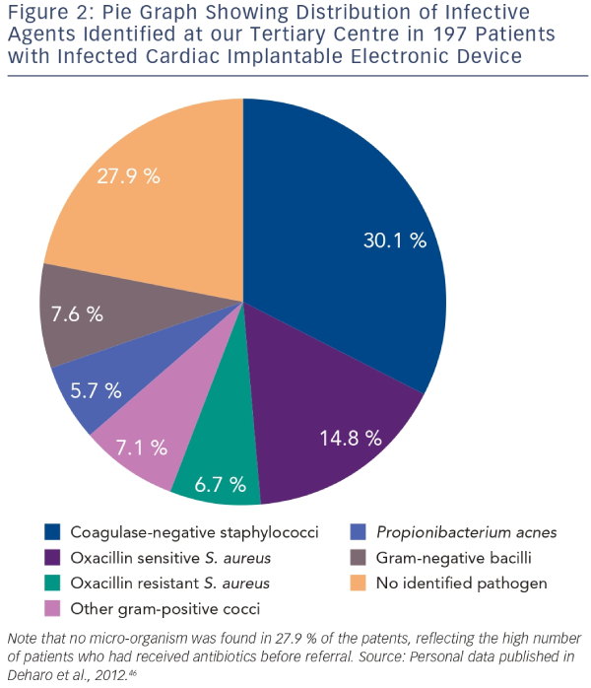
Podoleanu C, Deharo JC
Graph Showing Distribution of Infective Agents Identified at our Tertiary Centre in 197 Patients with Infected Cardiac Implantable Electronic Device
Citation: Arrhythmia & Electrophysiology Review 2014;3(3):184–90
https://doi.org/10.15420/aer.2014.3.3.184

