Slide 1
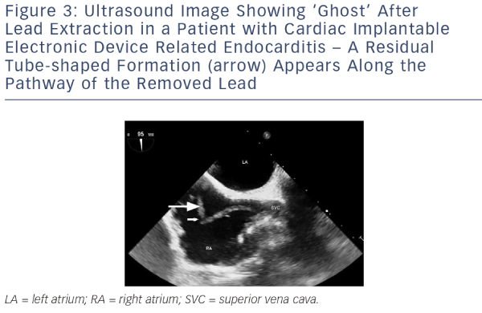
Podoleanu C, Deharo JC
Ultrasound Image Showing ‘Ghost’ After Lead Extraction in a Patient with Cardiac Implantable Electronic Device Related Endocarditis – A Residual Tube-shaped Formation (arrow) Appears Along the Pathway of the Removed Lead
Citation: Arrhythmia & Electrophysiology Review 2014;3(3):184–90
https://doi.org/10.15420/aer.2014.3.3.184

