Slide 1
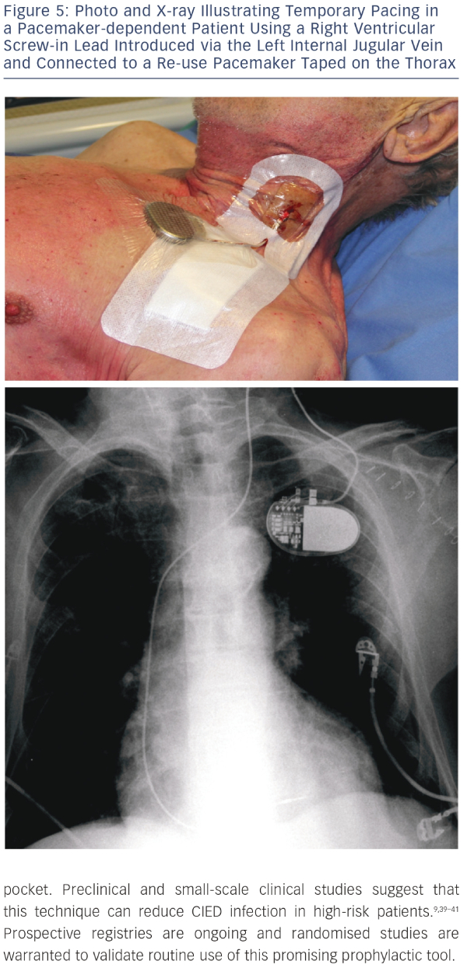
Podoleanu C, Deharo JC
Photo and X-ray Illustrating Temporary Pacing in a Pacemaker-dependent Patient Using a Right Ventricular Screw-in Lead Introduced via the Left Internal Jugular Vein and Connected to a Re-use Pacemaker Taped on the Thorax
Citation: Arrhythmia & Electrophysiology Review 2014;3(3):184–90
https://doi.org/10.15420/aer.2014.3.3.184

