Slide 1
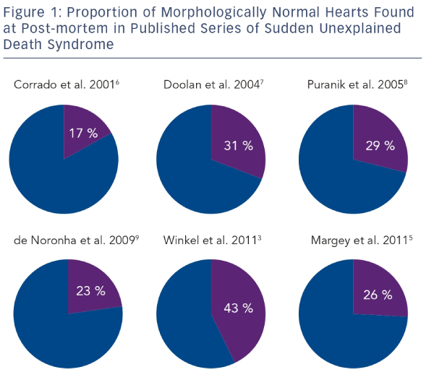
Mellor G, Behr ER
Proportion of Morphologically Normal Hearts Found at Post-mortem in Published Series of Sudden Unexplained Death Syndrome
Citation: Arrhythmia & Electrophysiology Review 2014;3(3):156–60
https://doi.org/10.15420/aer.2014.3.3.156

