Slide 1
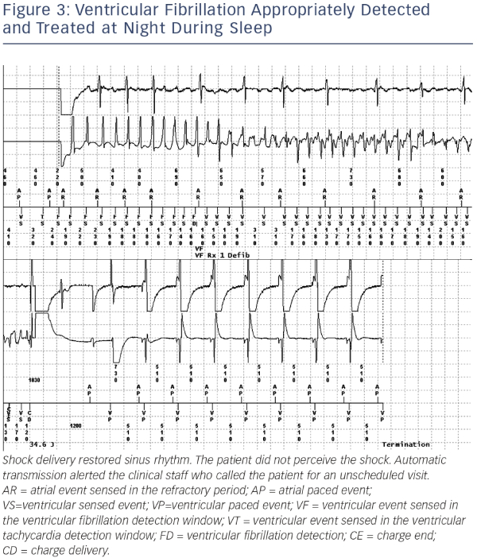
Varma N, Ricci RP, Morichelli L
Ventricular Fibrillation Appropriately Detected and Treated at Night During Sleep
Citation: Arrhythmia & Electrophysiology Review 2014;3(2):123–8
https://doi.org/10.15420/aer.2014.3.2.123

