Slide 1
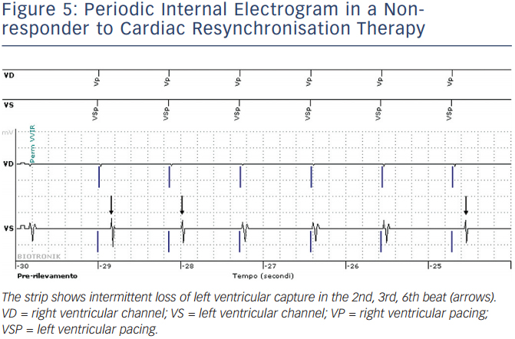
Varma N, Ricci RP, Morichelli L
Periodic Internal Electrogram in a Nonresponder to Cardiac Resynchronisation Therapy
Citation: Arrhythmia & Electrophysiology Review 2014;3(2):123–8
https://doi.org/10.15420/aer.2014.3.2.123

