Slide 1
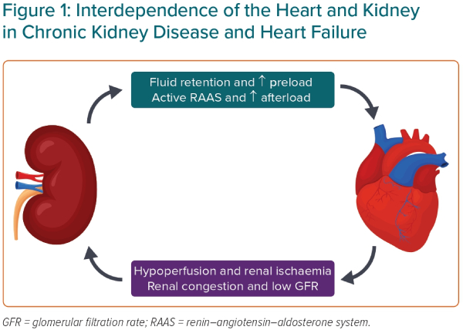
Singh Parmar S, Muthuppalaniappan V, Banerjee D
Interdependence of the Heart and Kidney in Chronic Kidney Disease and Heart Failure
Citation: European Cardiology Review 2023;18:e51.
https://doi.org/10.15420/ecr.2022.64

