Slide 1
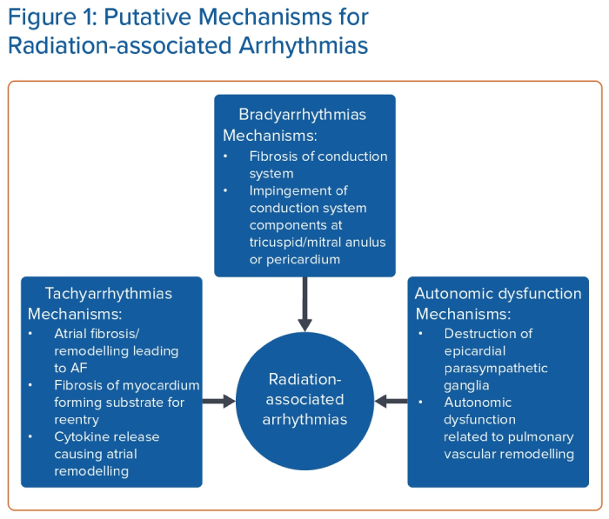
Bedi R, Ahmad A, Horbal P, Mar PL
Putative Mechanisms for Radiation-associated Arrhythmias
Citation: Arrhythmia & Electrophysiology Review 2023;12:e24.
https://doi.org/10.15420/aer.2022.44

