Slide 1
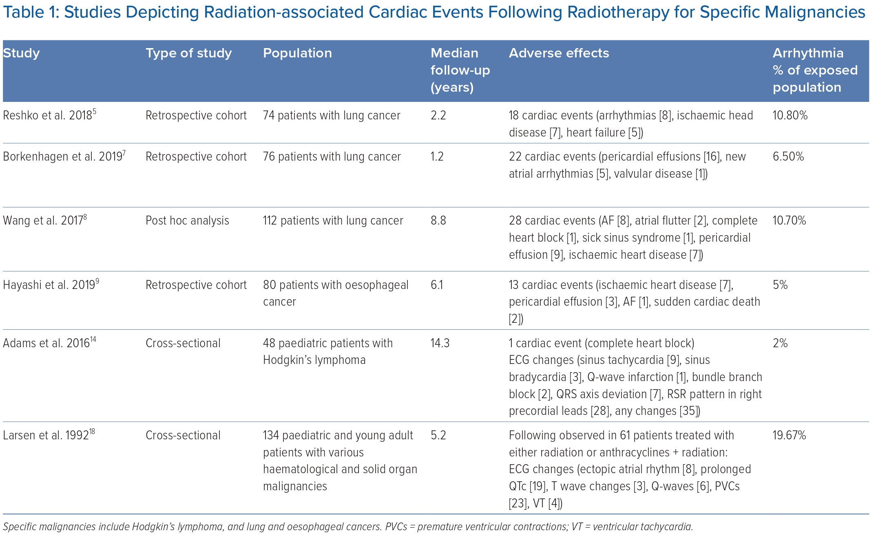
Bedi R, Ahmad A, Horbal P, Mar PL
Studies Depicting Radiation-associated Cardiac Events Following Radiotherapy for Specific Malignancies
Citation: Arrhythmia & Electrophysiology Review 2023;12:e24.
https://doi.org/10.15420/aer.2022.44

