Slide 1
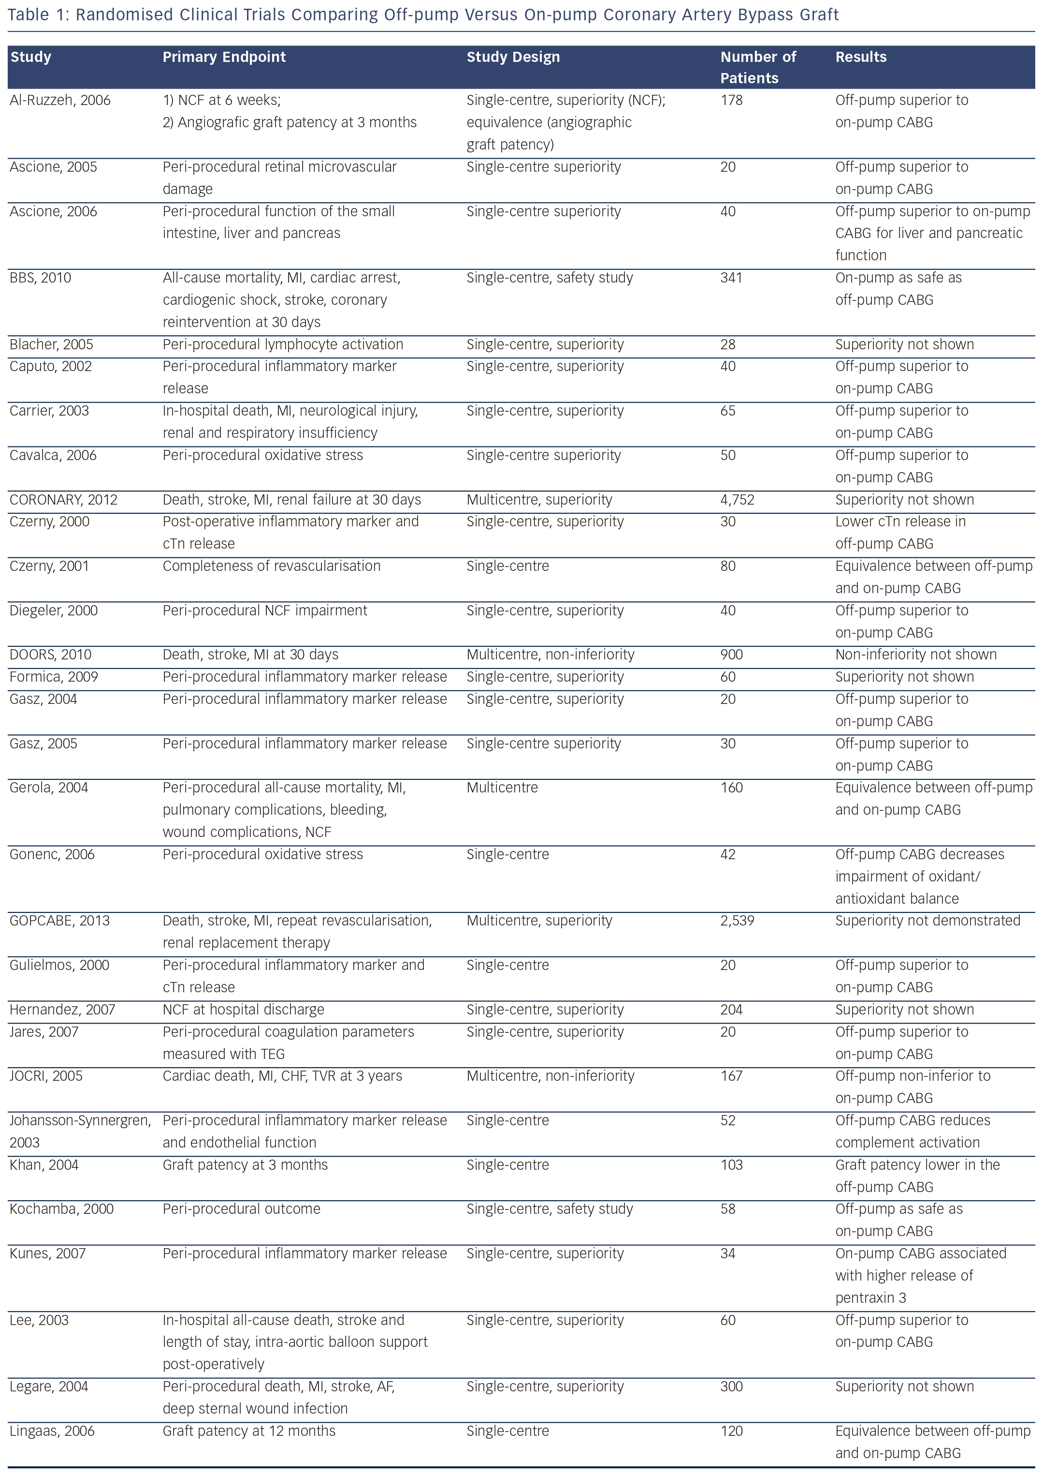
Palmerini T, Savini C, Di Eusanio M
Randomised Clinical Trials Comparing Off-pump Versus On-pump Coronary Artery Bypass Graft
Citation: Interventional Cardiology Review 2014;9(2):77–83
https://doi.org/10.15420/icr.2011.9.2.77

