Slide 1
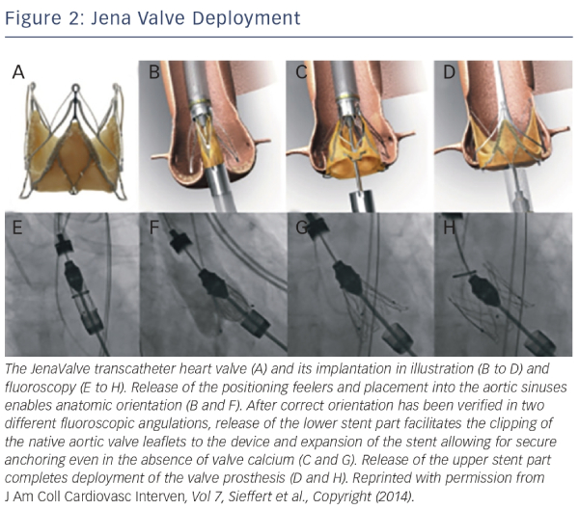
Spina R, Anthony C, Muller DW, Roy D
Jena Valve Deployment
Citation: Interventional Cardiology Review 2015;10(1):49–54
https://doi.org/10.15420/icr.2015.10.1.49

