Slide 1
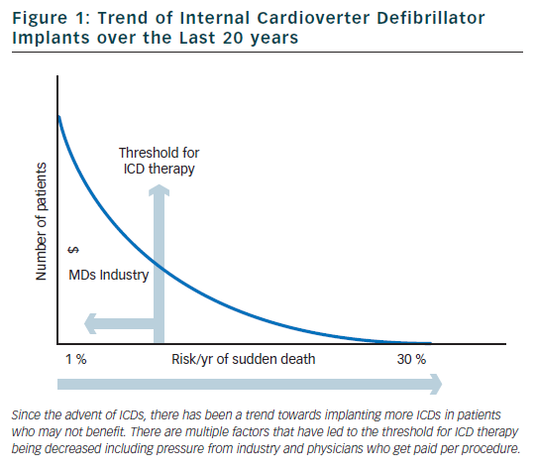
Silverstein JR, Katritsis DG, Josephson ME
Figure 1: Trend of Internal Cardioverter Defibrillator Implants over the Last 20 years
Citation: Arrhythmia & Electrophysiology Review 2012;1(1):46–50
https://doi.org/10.15420/aer.2012.1.46

