Slide 1
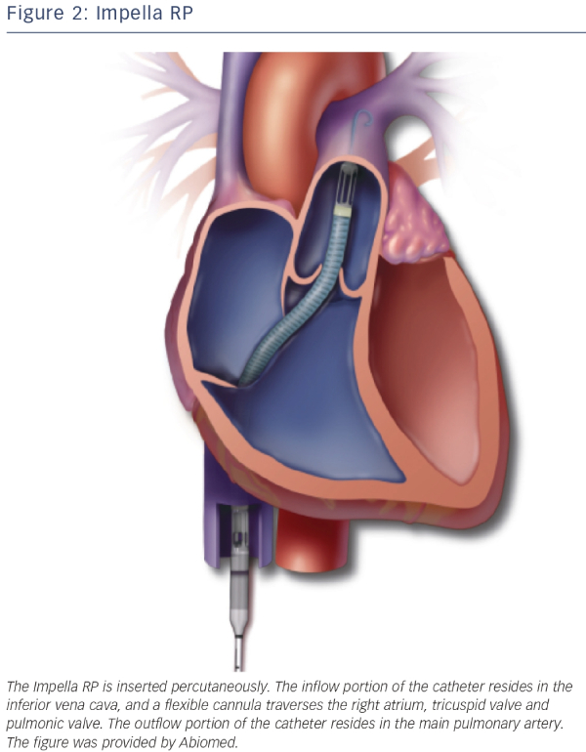
Ouweneel DM, Claessen BE, Sjauw KD, Henriques JP
Impella RP
Citation: Interventional Cardiology Review 2015;10(1):39–44
https://doi.org/10.15420/icr.2015.10.1.39

