Slide 1
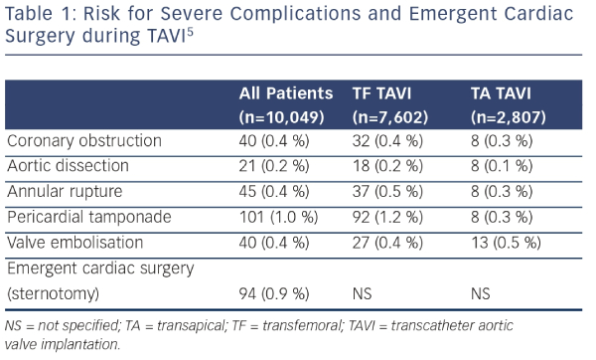
Eggebrecht H, Schmermund A
Risk for Severe Complications and Emergent Cardiac Surgery during TAVI5
Citation: Interventional Cardiology Review 2015;10(1):55–7
https://doi.org/10.15420/icr.2015.10.1.55

