Slide 1
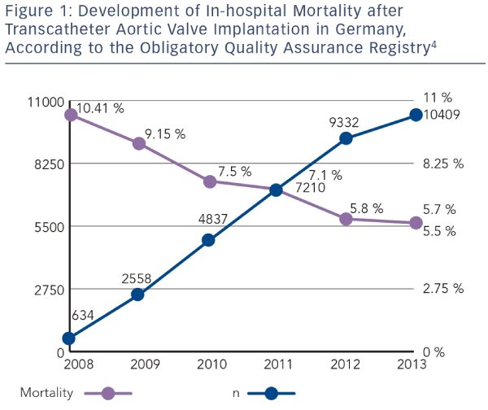
Eggebrecht H, Schmermund A
Development of In-hospital Mortality after Transcatheter Aortic Valve Implantation in Germany, According to the Obligatory Quality Assurance Registry4
Citation: Interventional Cardiology Review 2015;10(1):55–7
https://doi.org/10.15420/icr.2015.10.1.55

