Slide 1
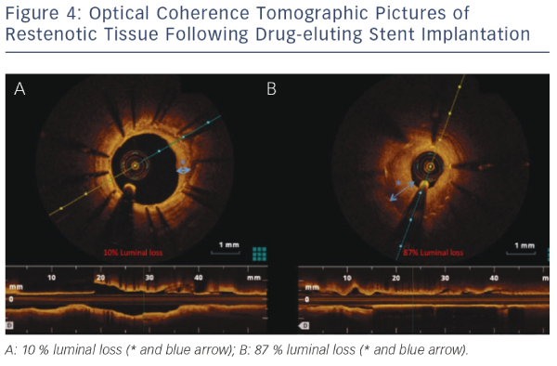
Rathod KS, Hamshere SM, Jones DA, Mathur A
Optical Coherence Tomographic Pictures of Restenotic Tissue Following Drug-eluting Stent Implantation
Citation: Interventional Cardiology Review 2015;10(1):8–15
https://doi.org/10.15420/icr.2015.10.1.8

