Slide 1
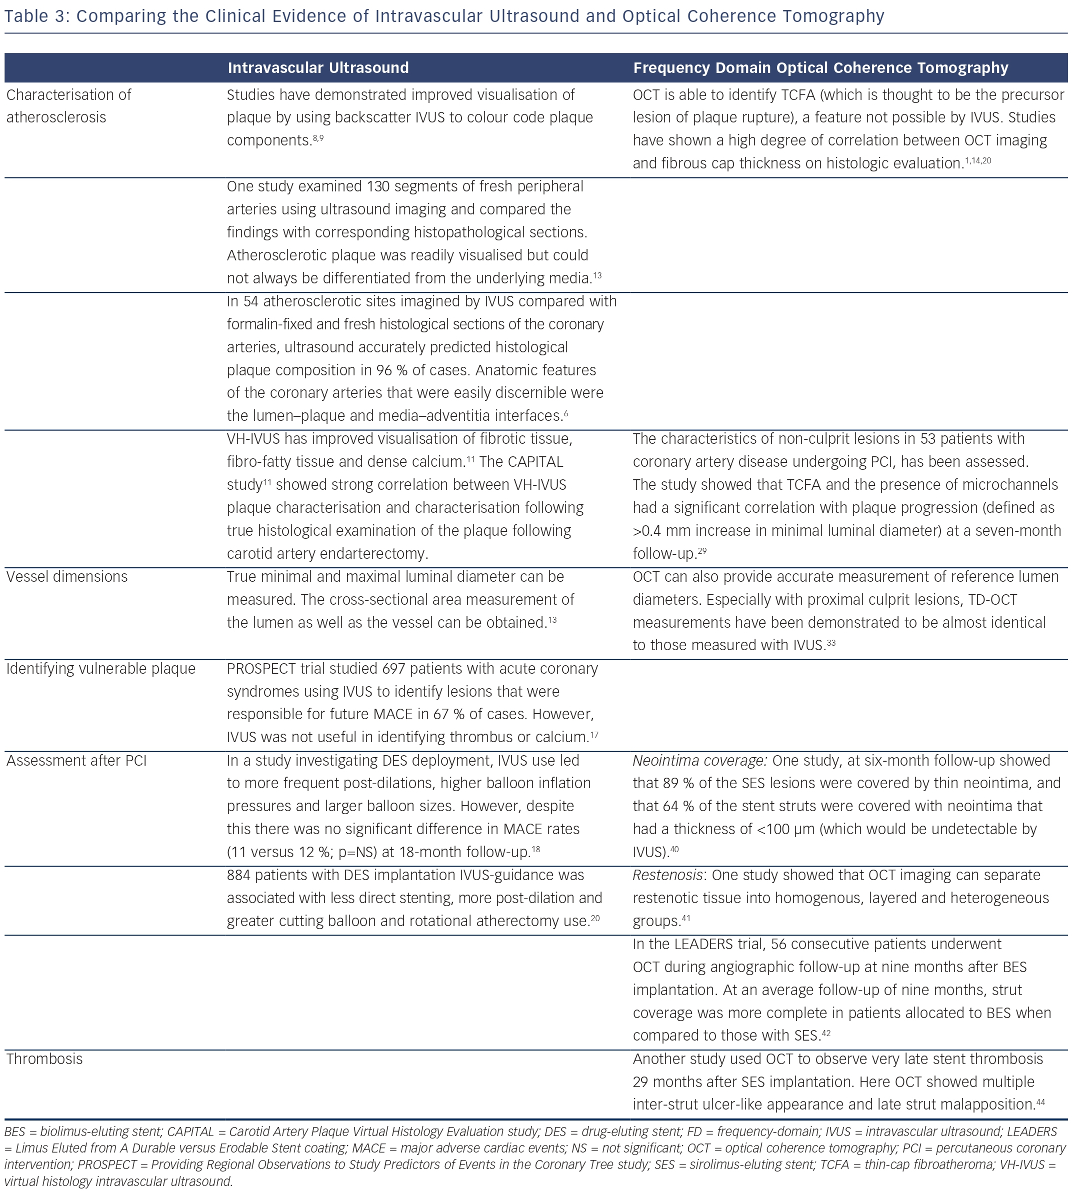
Rathod KS, Hamshere SM, Jones DA, Mathur A
Comparing the Clinical Evidence of Intravascular Ultrasound and Optical Coherence Tomography
Citation: Interventional Cardiology Review 2015;10(1):8–15
https://doi.org/10.15420/icr.2015.10.1.8

