Slide 1
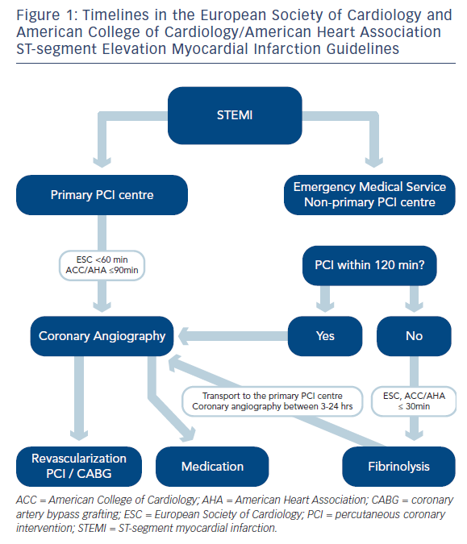
Kala P
Timelines in the European Society of Cardiology and American College of Cardiology/American Heart Association ST-segment Elevation Myocardial Infarction Guidelines
Citation: Interventional Cardiology Review 2014;9(1):7–10
https://doi.org/10.15420/icr.2011.9.1.7

