Slide 1
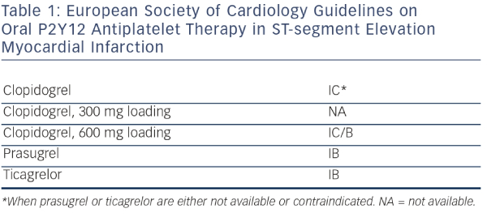
Kala P
European Society of Cardiology Guidelines on Oral P2Y12 Antiplatelet Therapy in ST-segment Elevation Myocardial Infarction
Citation: Interventional Cardiology Review 2014;9(1):7–10
https://doi.org/10.15420/icr.2011.9.1.7

