Slide 1
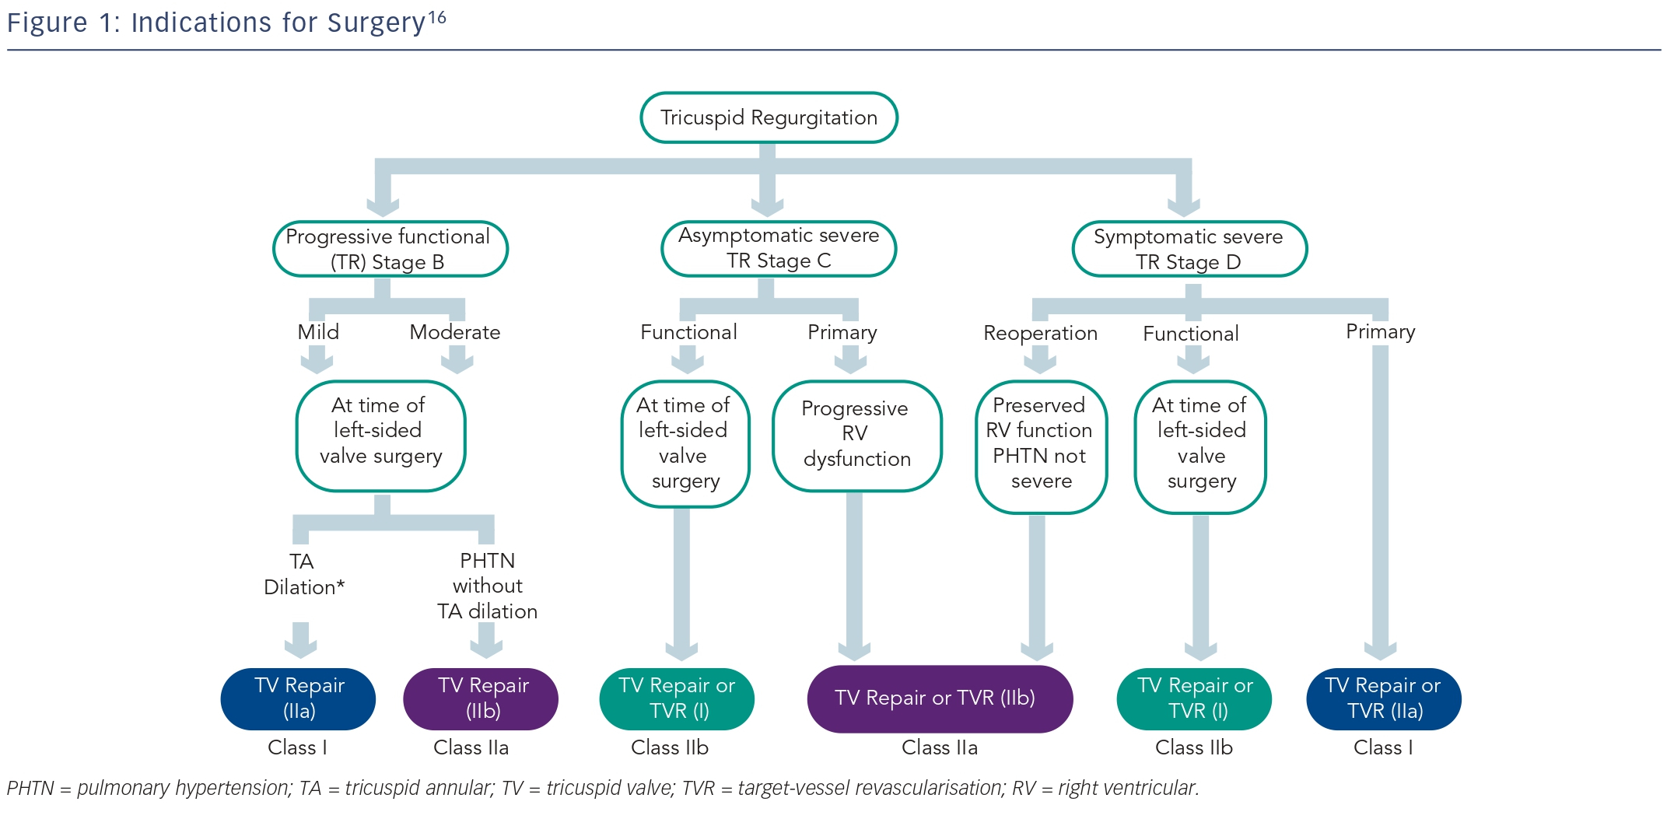
Topilsky Y
Indications for Surgery16
Citation: Interventional Cardiology Review 2015;10(1):58–60
https://doi.org/10.15420/icr.2015.10.1.58

