Slide 1
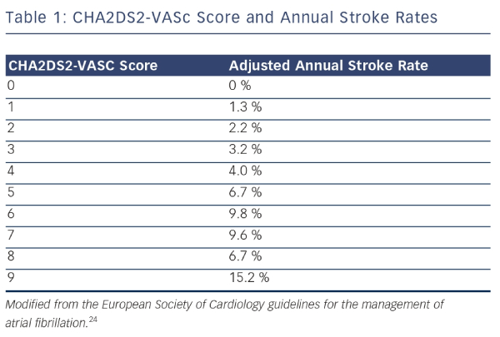
Archbold A
CHA2DS2-VASc Score and Annual Stroke Rates
Citation: Interventional Cardiology Review 2015;10(1):16–21
https://doi.org/10.15420/icr.2015.10.1.16

