Slide 1
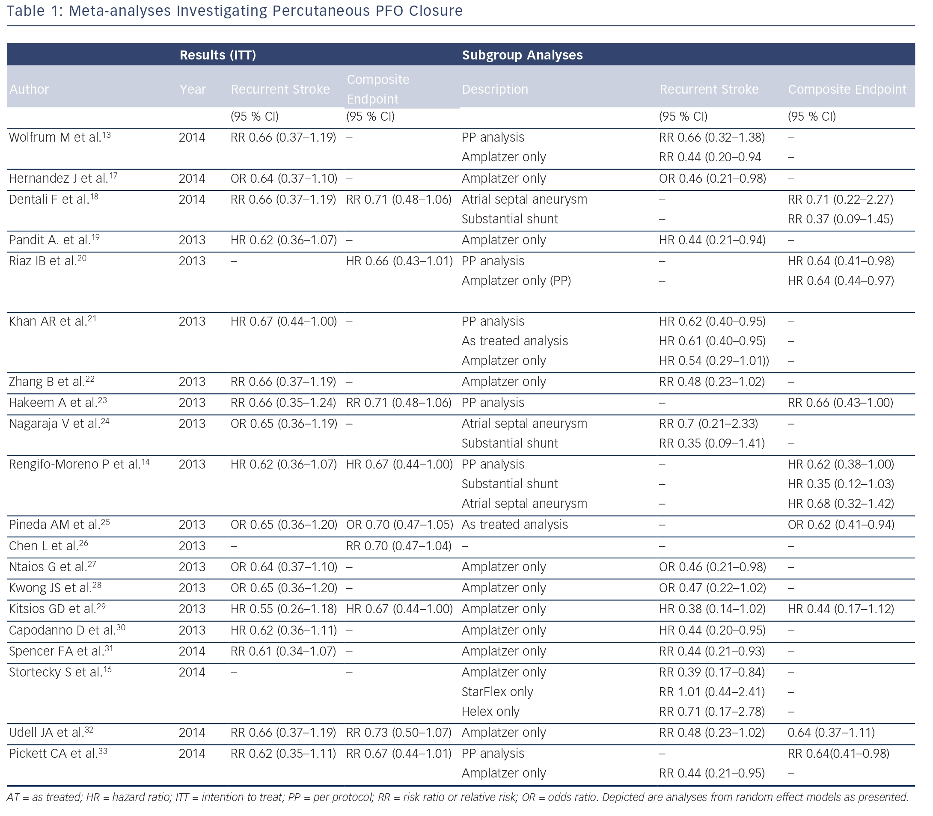
Stortecky S, Windecker S
Meta-analyses Investigating Percutaneous PFO Closure
Citation: Interventional Cardiology Review 2015;10(1):45–8
https://doi.org/10.15420/icr.2015.10.1.45

