Slide 1
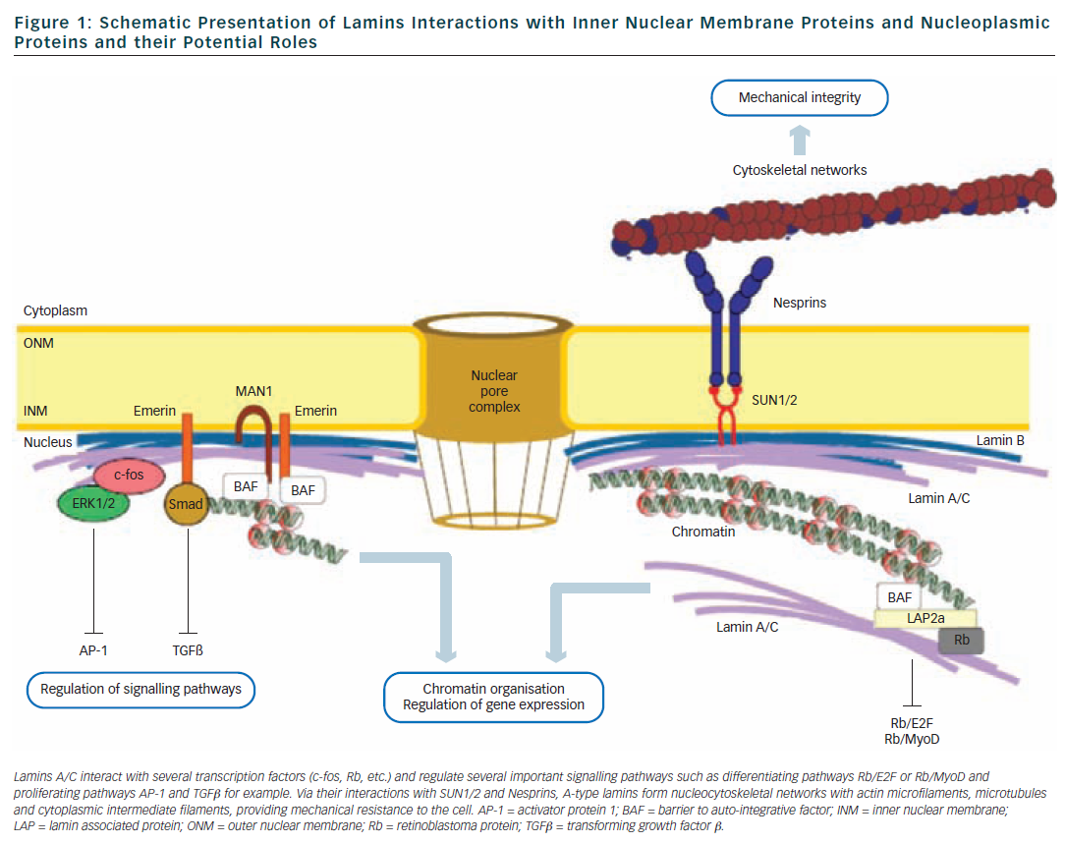
Charron P, Arbustini E, Bonne G
Figure 1: Schematic Presentation of Lamins Interactions
Citation: Arrhythmia & Electrophysiology Review 2012;1(1):22–8
https://doi.org/10.15420/aer.2012.1.22

