Slide 1
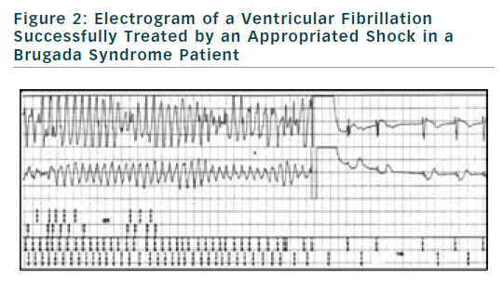
Probst V, Chatel S, Gourraud JB, Le Marec H
Figure 2: Electrogram of a Ventricular Fibrillation Successfully Treated by an Appropriated Shock in a Brugada Syndrome Patient
Citation: Arrhythmia & Electrophysiology Review 2012;1(1):17–21
https://doi.org/10.15420/aer.2012.1.17

