Slide 1
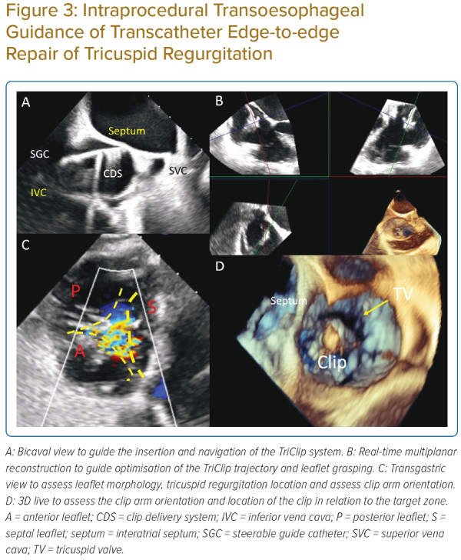
So Cy, Fan Y, Su M, Wang Y, He B, Lee APW
Intraprocedural Transoesophageal Guidance of Transcatheter Edge-to-edge Repair of Tricuspid Regurgitation
Citation: Journal of Asian Pacific Society of Cardiology 2023;2:e32.
https://doi.org/10.15420/japsc.2022.41

