Slide 1
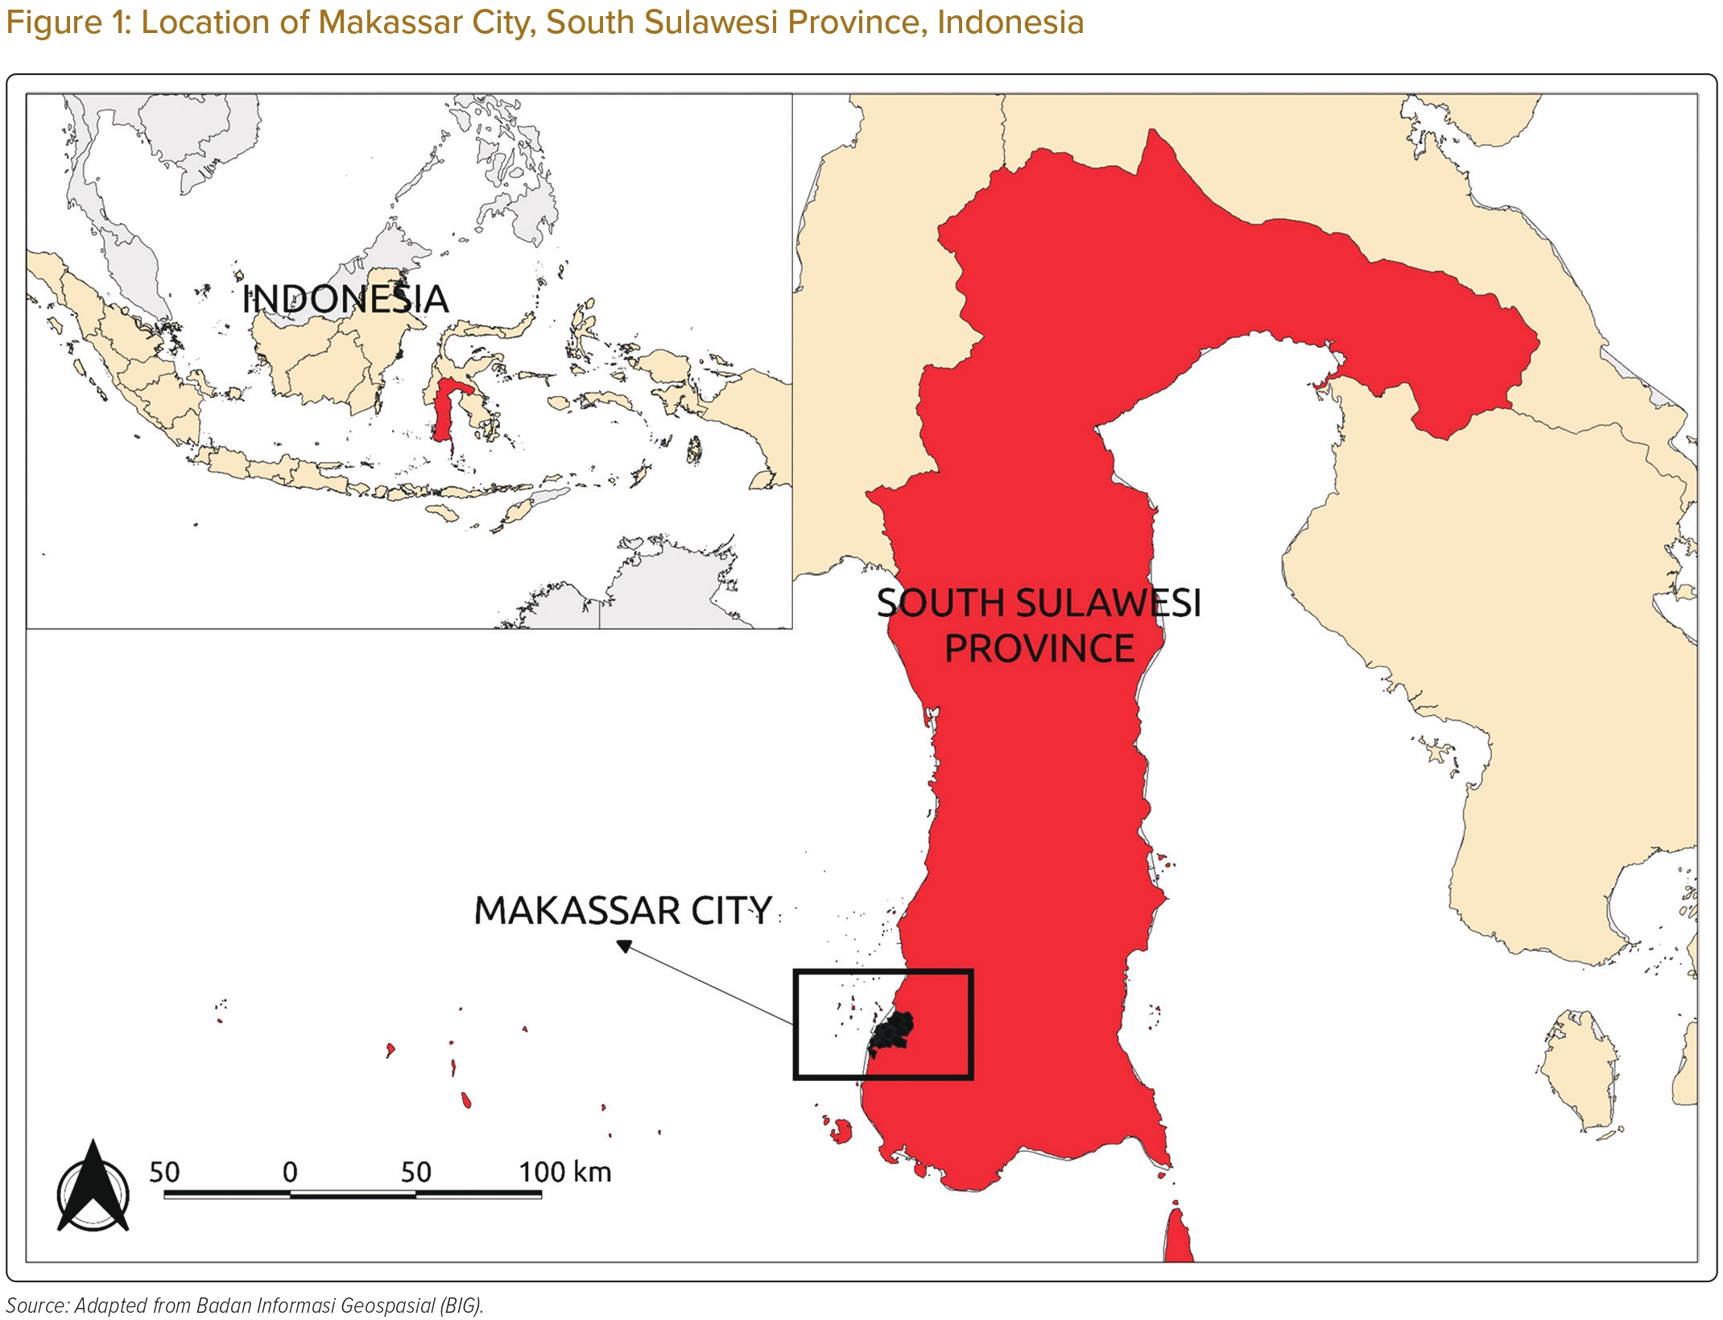
Sidik Arsyad D, HJ Hageman S, Qalby N, Ansariadi A, Wahiduddin W, Qanitha A, Mappangara I, Doevendans PA, LJ Visseren F, Cramer MJ
Location of Makassar City, South Sulawesi Province, Indonesia
Citation: Journal of Asian Pacific Society of Cardiology 2023;2:e33.
https://doi.org/10.15420/japsc.2023.04

