Slide 1

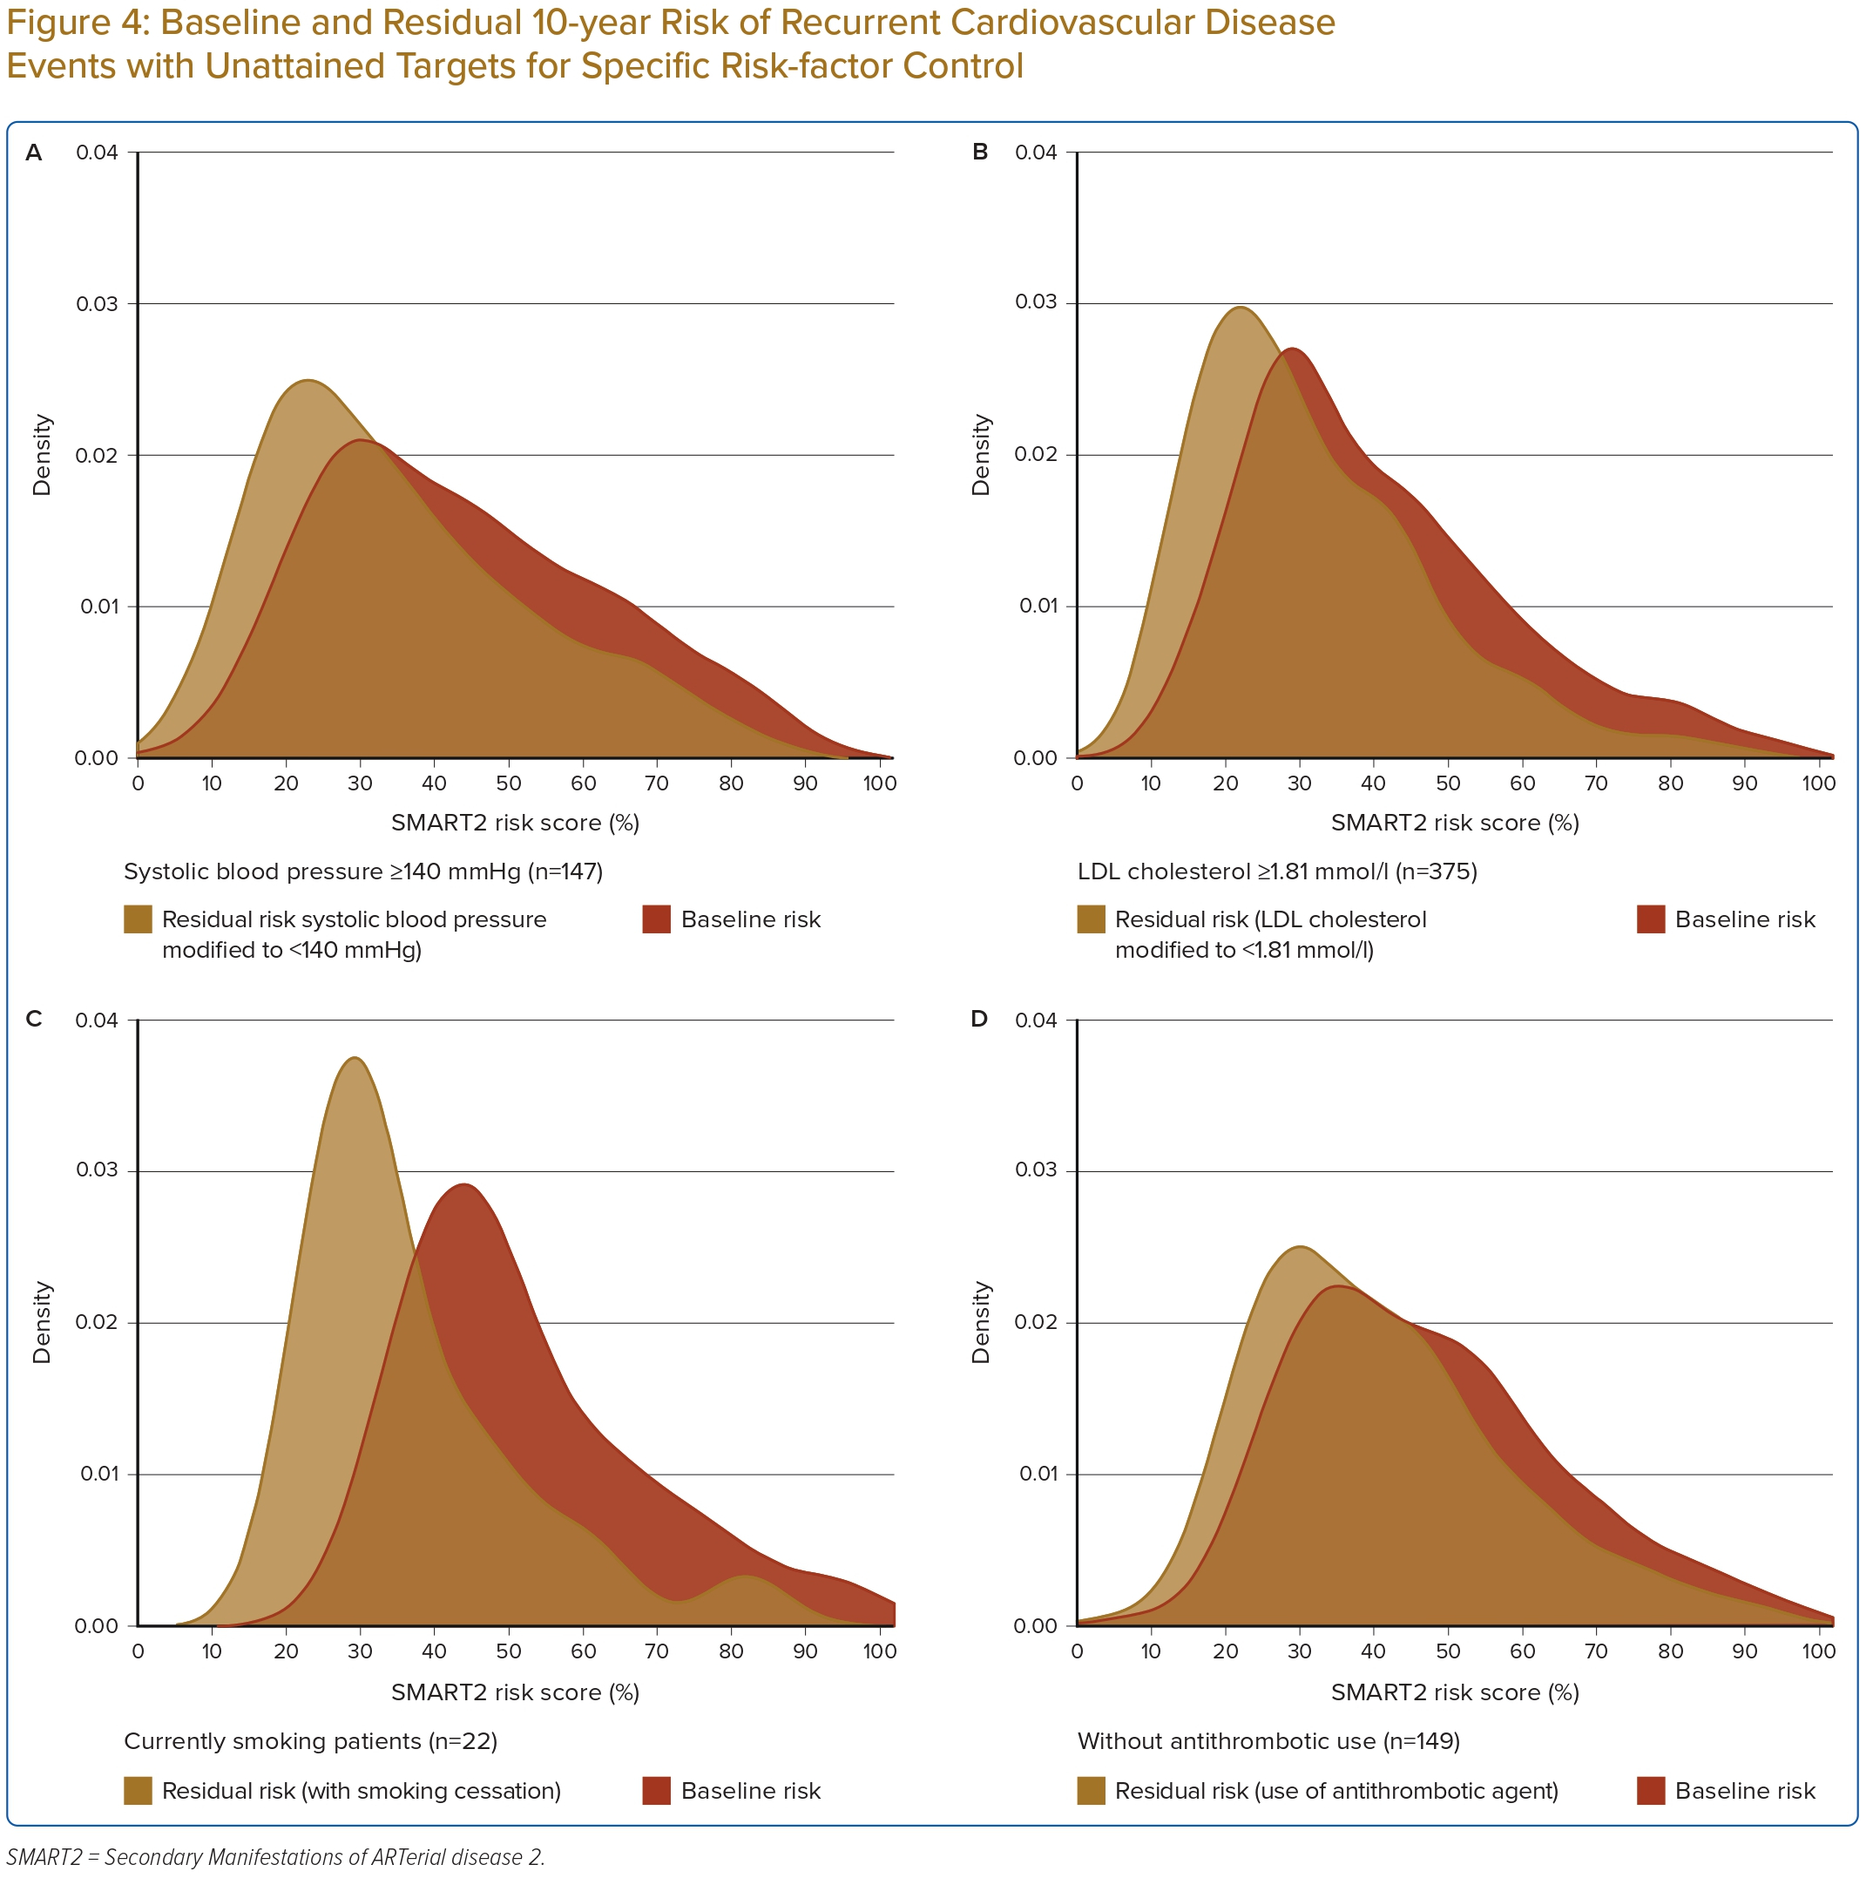
Sidik Arsyad D, HJ Hageman S, Qalby N, Ansariadi A, Wahiduddin W, Qanitha A, Mappangara I, Doevendans PA, LJ Visseren F, Cramer MJ
Baseline and Residual 10-year Risk of Recurrent Cardiovascular Disease Events with Unattained Targets for Specific Risk-factor Control
Citation: Journal of Asian Pacific Society of Cardiology 2023;2:e33.
https://doi.org/10.15420/japsc.2023.04

