Slide 1
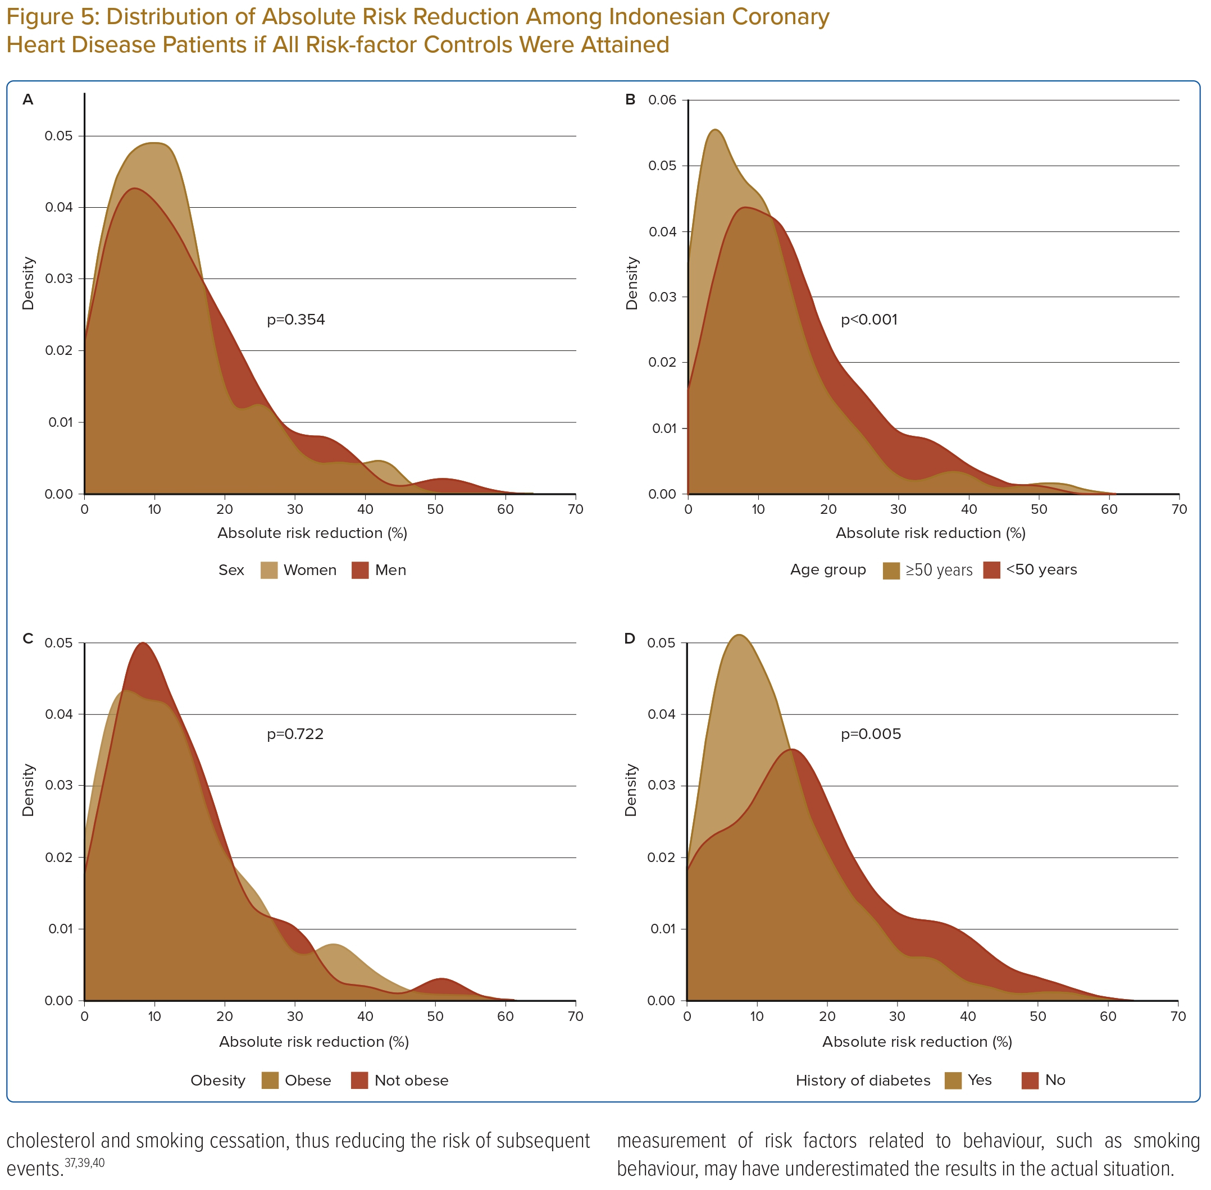
Sidik Arsyad D, HJ Hageman S, Qalby N, Ansariadi A, Wahiduddin W, Qanitha A, Mappangara I, Doevendans PA, LJ Visseren F, Cramer MJ
Distribution of Absolute Risk Reduction Among Indonesian Coronary Heart Disease Patients if All Risk-factor Controls Were Attained
Citation: Journal of Asian Pacific Society of Cardiology 2023;2:e33.
https://doi.org/10.15420/japsc.2023.04

