Slide 1
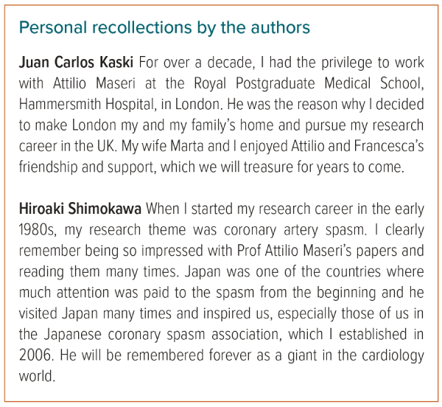
Kaski JC, Shimokawa H
Coronary Artery Spasm: A Special Focus Issue
Citation: European Cardiology Review 2023;2:e53.
https://doi.org/10.15420/ecr.2023.11

