Slide 1

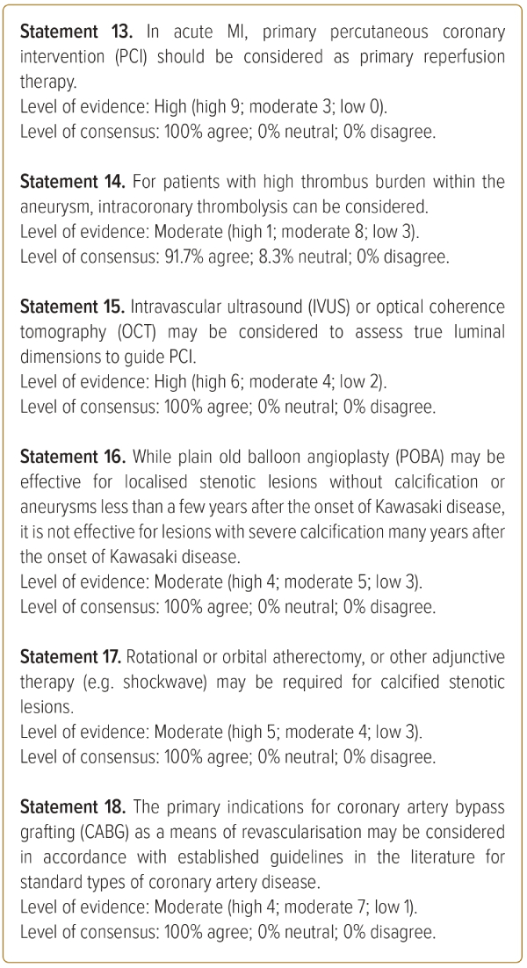
Yeo KK, Fukazawa R, Ayusawa M, Lin MT, Maemura K, Tern P, Johar S, Lilyasari O, Leus A, Lo ST, Yokoi H, Mitani Y
Asian Pacific Society of Cardiology Consensus Statement on Management of Coronary Artery Disease in Adults with Late Complications of Kawasaki Disease
Citation: Journal of Asian Pacific Society of Cardiology 2023;2:e34.
https://doi.org/10.15420/japsc.2022.30

