Slide 1
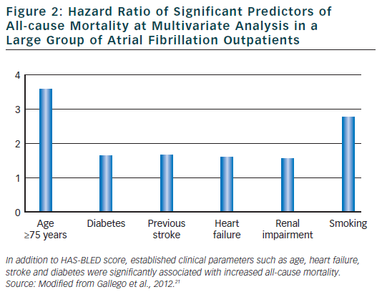
Lombardi F
Figure 2: Hazard Ratio of Significant Predictors of All-cause Mortality
Citation: Arrhythmia & Electrophysiology Review 2012;1(1):8–11
https://doi.org/10.15420/aer.2012.1.8

