Slide 1
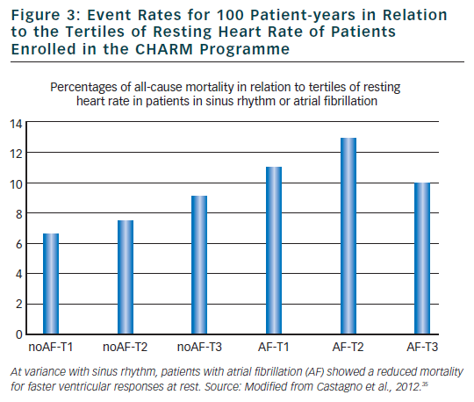
Lombardi F
Figure 3: Event Rates for 100 Patient-years in Relation
Citation: Arrhythmia & Electrophysiology Review 2012;1(1):8–11
https://doi.org/10.15420/aer.2012.1.8

