Slide 1
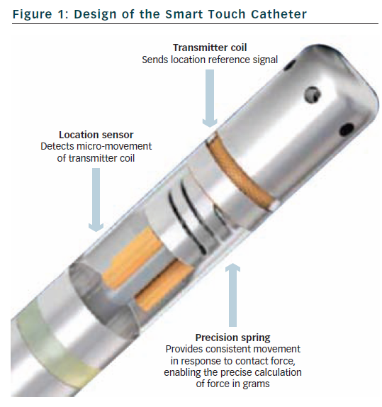
Page SP, Dhinoja M
Figure 1: Design of the Smart Touch Catheter
Citation: Arrhythmia & Electrophysiology Review 2012;1(1):59–62
https://doi.org/10.15420/aer.2012.1.59

