Slide 1
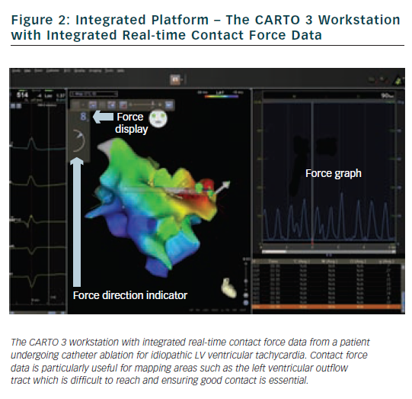
Page SP, Dhinoja M
Figure 2: Integrated Platform – The CARTO 3 Workstation with Integrated Real-time Contact Force Data
Citation: Arrhythmia & Electrophysiology Review 2012;1(1):59–62
https://doi.org/10.15420/aer.2012.1.59

