Slide 1
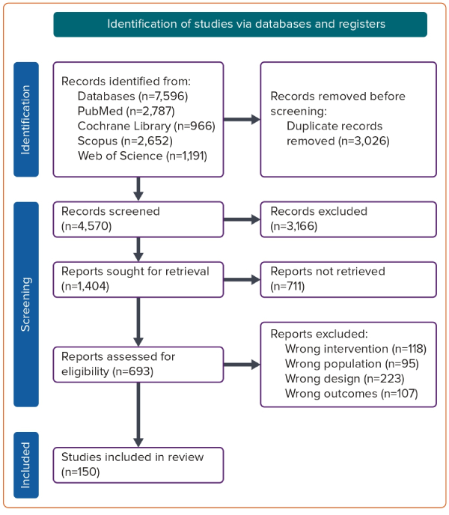
Khaity A, Rababah AAM, Abdelwahab OA, Albakri K, Adel Diab R, Mostafa Al-dardery N, Abbassy M, Al-Hanaqtah BM, Awad AK, Mohamad T
Figure 1: PRISMA Flow Diagram of Study Screening and Selection
Citation: European Cardiology Review 2023;18:e54.
https://doi.org/10.15420/ecr.2023.01

