Slide 1
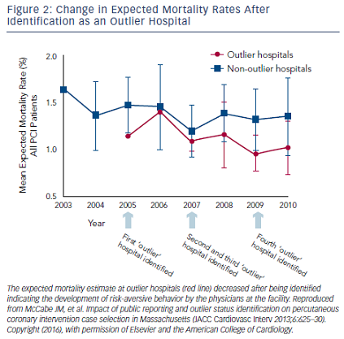
Dehmer GJ
Change in Expected Mortality Rates After Identification as an Outlier Hospital
Citation: US Cardiology Review 2016;10(1):36–40
https://doi.org/10.15420/usc.2016.10.1.36

