Slide 1
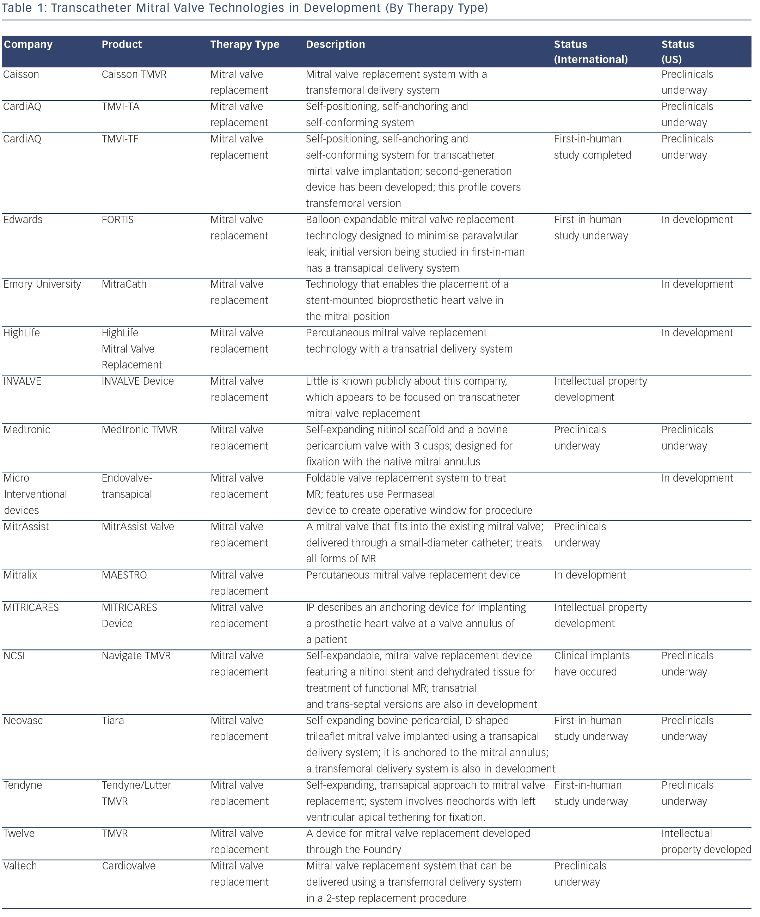
Mountfort K
Transcatheter Mitral Valve Technologies in Development (By Therapy Type)
Citation: RadcliffeCardiology.com, August 2014.

