Slide 1
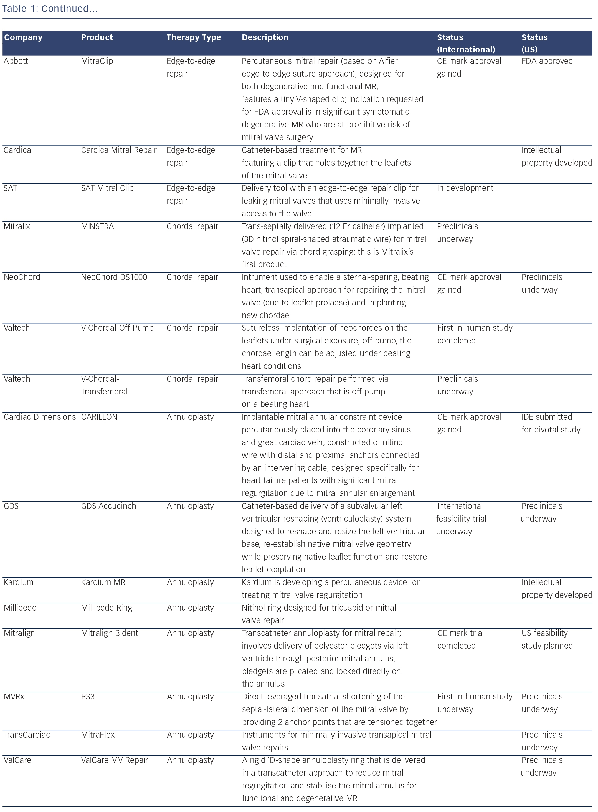
Mountfort K
Continued...
Citation: RadcliffeCardiology.com, August 2014.

