Slide 1

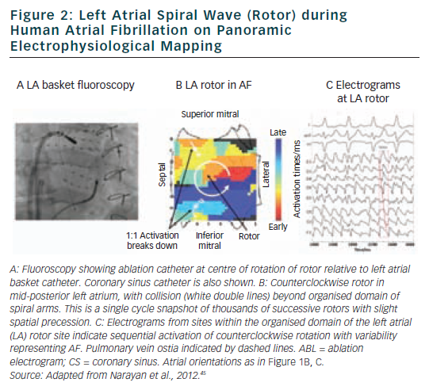
Narayan SM, Krummen DE
Figure 2: Left Atrial Spiral Wave (Rotor) during Human Atrial Fibrillation on Panoramic Electrophysiological Mapping
Citation: Arrhythmia & Electrophysiology Review 2012;1(1):34–8
https://doi.org/10.15420/aer.2012.1.34

