Slide 1
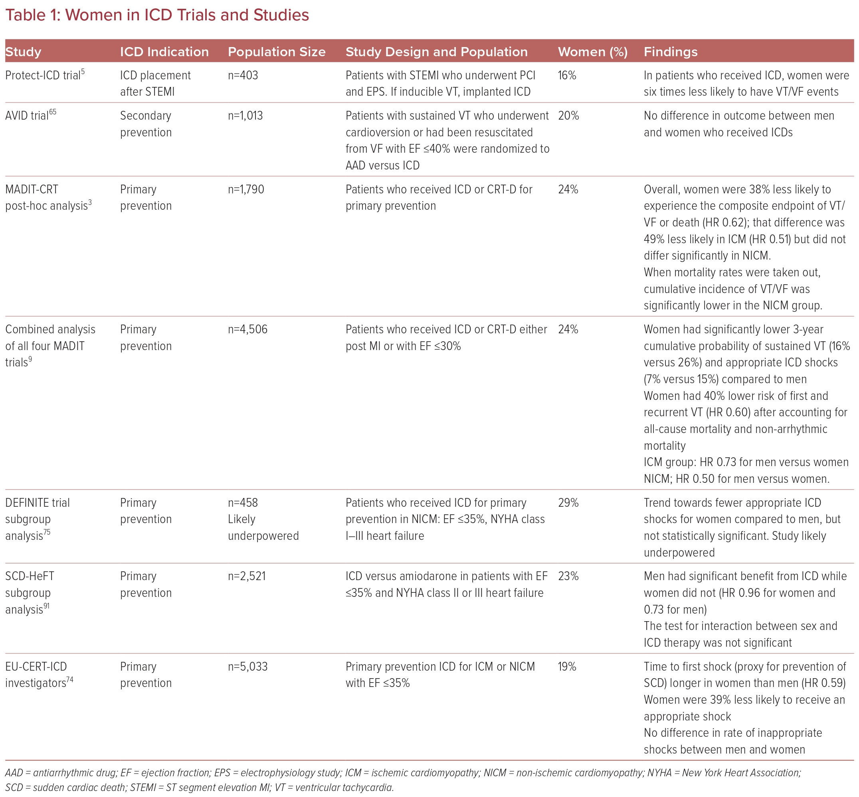
Koch Warnock R, Modi RD, Westerman SB
Women in ICD Trials and Studies
Citation: US Cardiology Review 2023;17:e12.
https://doi.org/10.15420/usc.2022.38

