Slide 1
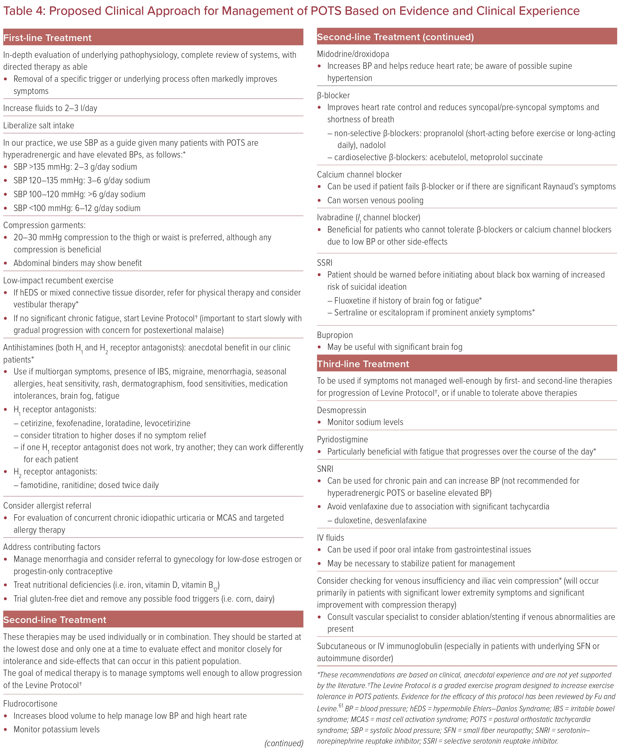
Steinberg RS, Dicken W, Cutchins A
Proposed Clinical Approach for Management of POTS Based on Evidence and Clinical Experience
Citation: US Cardiology Review 2023;17:e13.
https://doi.org/10.15420/usc.2022.35

