Slide 1
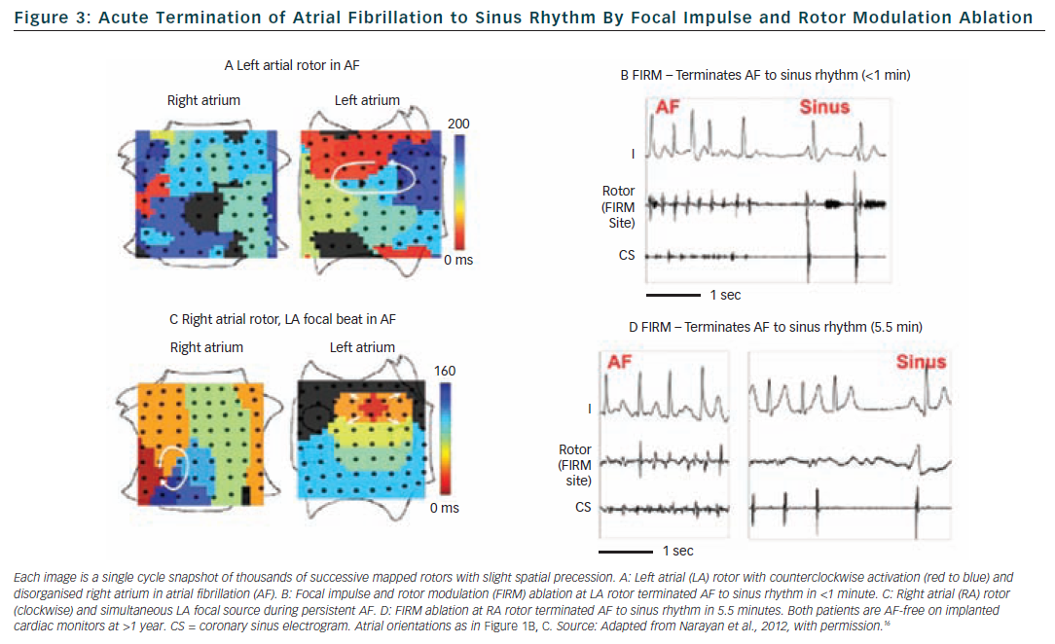
Narayan SM, Krummen DE
Figure 3: Acute Termination of Atrial Fibrillation to Sinus Rhythm By Focal Impulse and Rotor Modulation Ablation
Citation: Arrhythmia & Electrophysiology Review 2012;1(1):34–8
https://doi.org/10.15420/aer.2012.1.34

