Slide 1
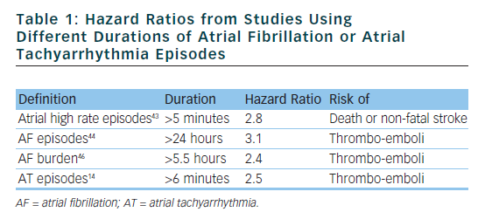
Lewalter T, Boriani G
Hazard Ratios from Studies
Citation: Arrhythmia & Electrophysiology Review 2012;1(1):54–8
https://doi.org/10.15420/aer.2012.1.54

